Slide 1
2024 Fourth Quarter Outlook
Can Rate Cuts Stem the Labor Market’s Slowdown
--Rep Name
--Firm-Approved Title
--Registered Branch Address
--Approved Email and/or Registered Phone
--Securities Disclosure
Enter all information and submit to Ad Review for final approval

Slide 2
Outlook: Agenda
The Fed’s New Cycle
Softening Economy
Election/Volatility
Notes:
Going into the year, our three themes were that the Fed would go from foe to friend and finally cut interest rates, the economy would cool into a soft-landing and volatility would pick up. These three themes are playing out, apart from volatility picking up. However, the potential drivers for volatility are still there and we would not be surprised to see some volatility heading into 2025. Let’s get started with the Fed, whose projections for 2024 were also pretty good.

Slide 3
The Fed’s New Interest Rate Cycle
Notes:
Going into the year, our three themes were that the Fed would go from foe to friend and finally cut interest rates, the economy would cool into a soft-landing and volatility would pick up. These three themes are playing out, apart from volatility picking up. However, the potential drivers for volatility are still there and we would not be surprised to see some volatility heading into 2025. Let’s get started with the Fed, whose projections for 2024 were also pretty good.

Slide 4
The Preferred Measure of Inflation
Notes:
We predicted inflation would ease as did the Fed. The Fed’s median 2024 projection for inflation as measured by the Core Personal Consumption Expenditure Price Index, was 2.4%
If we take Core PCE through the last data point in July and use the last 3-months as a gauge for the rest of the year, Core PCE would come in at 1.7% (The August PCE report will be released the end of September). Currently, the six-month annualized Core PCE inflation rate is 2.6% as seen in this chart. This relatively low inflation rate might be perplexing to many consumers, who feel inflation is still high, but inflation is the rate at which prices are rising, not the overall price level. As Fed Chair Jerome Powell mentioned in his last press conference: prices are high, not inflation. The overall price level from the end of 2019 to present rose by over 21%, as measured by the consumer price index. That is a big jump in a relatively small about of time, so it is hard to adjust. Prices are still rising but at a slower pace now. Unfortunately, we will not likely be going back to 2019 price levels. Positively, average hourly earnings have outpaced inflation over this time frame.

Slide 5
Will History Repeat?
Notes:
Perhaps another reason for rate cut optimism is the softening labor market. The unemployment rate is already at 4.2% and the trend seems to be higher. Typically, the unemployment rate bottoms and then spikes higher. It isn’t a gradual climb higher, so this is something we are watching very closely, as is the Federal Reserve.

Slide 6
Softening Economy
Notes:
The economy is weakening

Slide 7
High Borrowing Costs Taking a Toll
Notes:
Borrowing costs are taking their toll. Take a look at the housing sector. Rate cuts could potentially provide a boost to housing activity.

Slide 8
Manufacturing
Notes:
And manufacturing. This is the forward-looking component of the manufacturing survey. Below 50 is contractionary. The good news is that rate cuts should help interest rate sensitive parts of the economy like housing and manufacturing.

Slide 9
Loosen Up
Notes:
Banks are also loosening lending standards now. They don’t appear to be worried about a deep recession. If they did, lending standards would be getting tighter. The same is true in credit markets like high yield bonds.

Slide 10
Election/Volatility
Notes:
There are plenty of potential drivers for volatility, including the election.

Slide 11
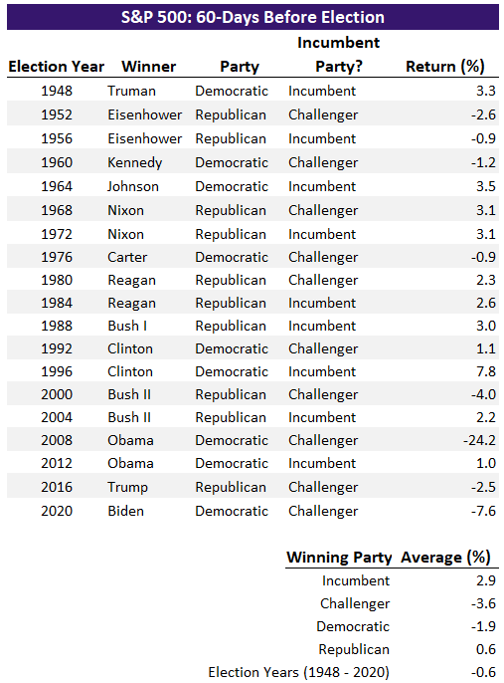
Pre-Election Returns
Source: Cetera Investment Management, FactSet, Standard & Poor’s. Return dates are the 60-days leading up to Election Day.
Notes:
We noted in past commentaries that stock returns in past election years are pretty good. Going back to 1960 the average S&P 500 return in election years was 10.5%. Regardless of if an incumbent party, challenger party, Democrat or Republican won, stocks were up, on average. The differences in returns can largely be explained by outliers unrelated to the election, such as the tech bubble and financial crisis.
We looked at the 60 days prior to the election. Leading up to the election was slightly negative, but again skewed by events such as the financial crisis and pandemic.

Slide 12
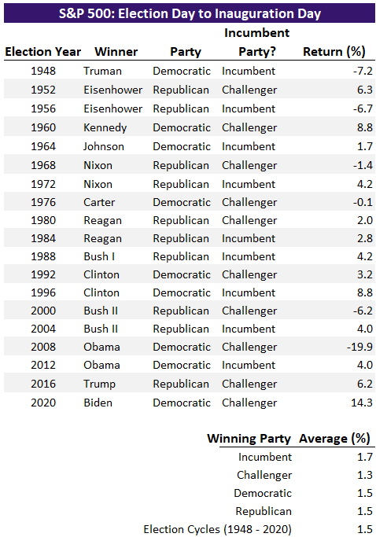
Post-Election Returns
Source: Cetera Investment Management, FactSet, Standard & Poor’s. Returns are from the day after Election Day to Inauguration Day.
Notes:
Returns after the election were positive. With that in mind, we could still see short-term volatility around the election.

Slide 13
How to Pay for Federal Spending Initiatives?
Source: Cetera Investment Management, FactSet, U.S. Congressional Budget Office (CBO). Above zero indicates a budget surplus and below zero indicates a deficit. The blue bars are CBO projections for 2024-2034.
Notes:
Regardless of who wins the election, the winner will likely be faced with a split congress, making any significant legislation like tax cuts or tax increases difficult. Even if the future president is fortunate enough to have his or her party in control of both chambers of Congress, big spending initiatives will be difficult due to budget constraints. Currently the United States is running large budget deficits and is projected to do so long into the future as seen in this chart. The grandest of plans will require money and both candidates would be reluctant to add significantly to this deficit.

Slide 14
What This Means for Markets
Notes:
What this means for markets?

Slide 15
Momentum and Breadth
Notes:
Start with backdrop. Momentum and breadth is improving. Large cap stocks have outpaced mid and small cap stocks but diversification is starting to pay off again.

Slide 16
High Valuations
Notes:
But, valuations are still high. Although this is mostly a large cap story and another reason why smaller cap stocks are starting to catch up.

Slide 17
Yield Curve
Notes:
The yield curve is improving which is a good sign for banks and maybe the economy. Banks pay depositors at short term interest rates for savings accounts and CDs. They make money with longer-term interest rates such as mortgages. When short-term rates are higher than longer-term rates that is problematic for banks. A reversal of this trend will help them.

Slide 18
Credit Spreads are Tight
Notes:
This high yield spread over risk-free Treasury bonds remains relatively tight though. Bond investors are not being rewarded as much for taking this extra risk. This is good news for the economy, as bond investors are telling us they view recession risk as low, but this can also change quickly. We are currently cautious on high yield bonds. We still recommend owning them as part of a diversified bond portfolio but are mindful of the risk and return relationship in this asset class. This chart shows the high yield spreads relative to their average. The average is skewed by recessions which are highlighted using gray bands, but you can still see that spreads are low relative to history.

Slide 19
Moving Pieces
Lower Rates
Soft Economy
Financials
REITs
Utilities
Technology
Consumer Staples
Utilities
Health Care
Election
Volatility
Chips, Electronics, Timber and Steel could benefit from tariffs and both parties have spoke about adding more.
Presidential elections usually don’t have much immediate market impact.
Risk is a close election with disputed winner (“hanging chad”).
Notes:
While a 0.50% cut in interest rates may not be a huge jolt to markets in the long run, it is significant in that we have officially entered a new interest rate cycle. Rather than wondering when the Fed would start to cut rates or even raise rates, now the conversations are more about how much they will cut rates in the coming meetings. There will be winners and losers both in equities and in fixed income. While each sector will have winners and losers within them, overall sectors that will potentially benefit from lower rates include Financials, REITs, Utilities and Technology. If the Fed does not meet investor expectations, these sectors could also be hurt by the Fed not cutting as much as expected.

Slide 20
Thank You. Follow Us: CeteraIM

Slide 21
Disclosures
About Cetera® Investment Management
Cetera Investment Management LLC is an SEC registered investment adviser owned by Cetera Financial Group®. Cetera Investment Management provides market perspectives, portfolio guidance, model management, and other investment advice to its affiliated broker-dealers, dually registered broker-dealers and registered investment advisers.
About Cetera® Financial Group
“Cetera Financial Group” refers to the network of independent retail firms encompassing, among others, Cetera Advisors LLC, Cetera Advisor Networks LLC, Cetera Investment Services LLC (marketed as Cetera Financial Institutions or Cetera Investors), and Cetera Financial Specialists LLC. All firms are members FINRA/SIPC. Located at 655 W. Broadway, 11th Floor, San Diego, CA 92101.
About Avantax
Avantax, Inc. (Avantax) is a wholly owned subsidiary of Aretec Group, Inc. (dba Cetera Holdings). Avantax is a unique community within Cetera Holdings. Avantax Investment Services, Inc., a subsidiary of Avantax, Member FINRA / SIPC. Located at 3200 Olympus Blvd, Suite 100, Dallas, TX, 75019. Avantax and Cetera Financial Group are under common ownership.
Individuals affiliated with Cetera firms are either Registered Representatives who offer only brokerage services and receive transaction-based compensation (commissions), Investment Adviser Representatives who offer only investment advisory services and receive fees based on assets, or both Registered Representatives and Investment Adviser Representatives, who can offer both types of services.
For more information about Cetera Investment Management, please reference the Cetera Investment Management LLC Form ADV disclosure brochure and the disclosure brochure for the registered investment adviser your adviser is registered with. Please consult with your adviser for his or her specific firm registrations and programs available.
No independent analysis has been performed and the material should not be construed as investment advice. Investment decisions should not be based on this material since the information contained here is a singular update, and prudent investment decisions require the analysis of a much broader collection of facts and context. All information is believed to be from reliable sources; however, we make no representation as to its completeness or accuracy. The opinions expressed are as of the date published and may change without notice. Any forward-looking statements are based on assumptions, may not materialize, and are subject to revision.
All economic and performance information is historical and not indicative of future results. The market indices discussed are not actively managed. Investors cannot directly invest in unmanaged indices. Please consult your financial advisor for more information.
Additional risks are associated with international investing, such as currency fluctuations, political and economic instability, and differences in accounting standards.
A diversified portfolio does not assure a profit or protect against loss in a declining market.

Slide 22
Glossary
The S&P 500 is an index of roughly 500 stocks chosen for market size, liquidity and industry grouping (among other factors) designed to be a leading indicator of U.S. equities and is meant to reflect the risk/return characteristics of the large cap universe.
The Russell 1000 Growth Index measures the performance of the large-cap growth segment of the U.S. equity universe. It includes those Russell 1000 Index companies with higher price-to-book ratios and higher forecasted growth values.
The Russell 1000 Value Index measures the performance of the large-cap value segment of the U.S. equity universe. It includes those Russell 1000 Index companies with lower price-to-book ratios and lower forecasted growth values.
The Chicago Board Options Exchange (CBOE) Volatility Index, commonly known by its ticker symbol VIX, is a measure of the stock market's expectation of volatility implied by S&P 500 index options.
The Bloomberg Barclays US Aggregate Bond Index is a broad based flagship benchmark that measures the investment grade, US dollar-denominated, fixed-rate taxable bond market. Eligible bonds must have at least one year until final maturity, but the index holdings have a fluctuating average life of around 8.25 years. This total return index is unhedged and rebalances monthly.
The ICE BofA US High Yield Index tracks the performance of US dollar denominated below investment grade rated corporate debt publicly issued in the U.S. domestic market. To qualify for inclusion in the index, securities must have a below investment grade rating (based on an average of Moody's, S&P, and Fitch) and an investment grade rated country of risk (based on an average of Moody's, S&P, and Fitch foreign currency long term sovereign debt ratings). Each security must have greater than 1 year of remaining maturity, a fixed coupon schedule, and a minimum amount outstanding of $100 million.
The Nasdaq Composite Index is a large, broad-based, market-cap-weighted index of more than 2,500 common equities listed on the Nasdaq stock exchange. It is often seen as a stand-in for the technology sector and its performance.

